Slide 1



A Knight’s Tour
-By Prafulla Shrestha

Slide 2

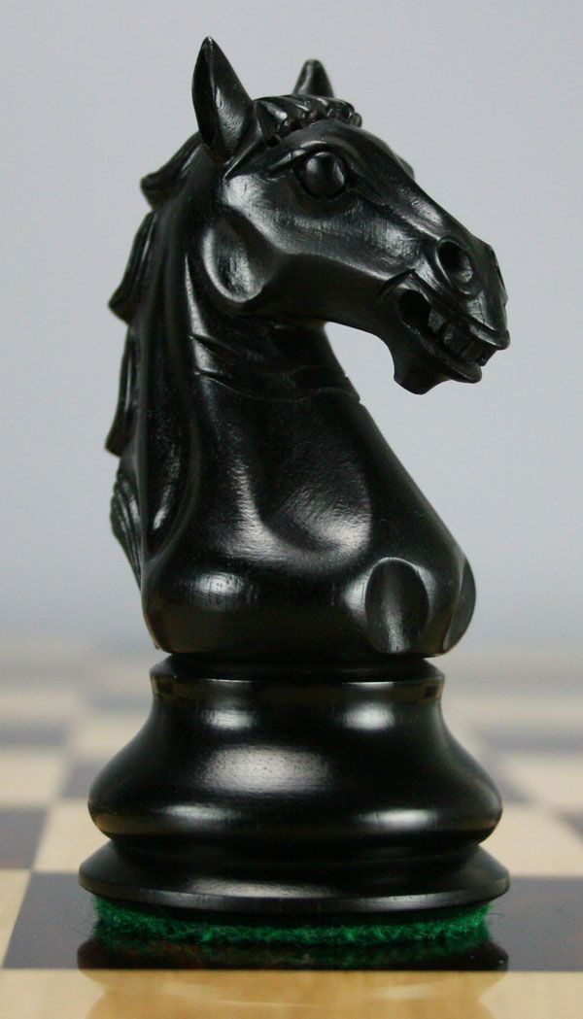

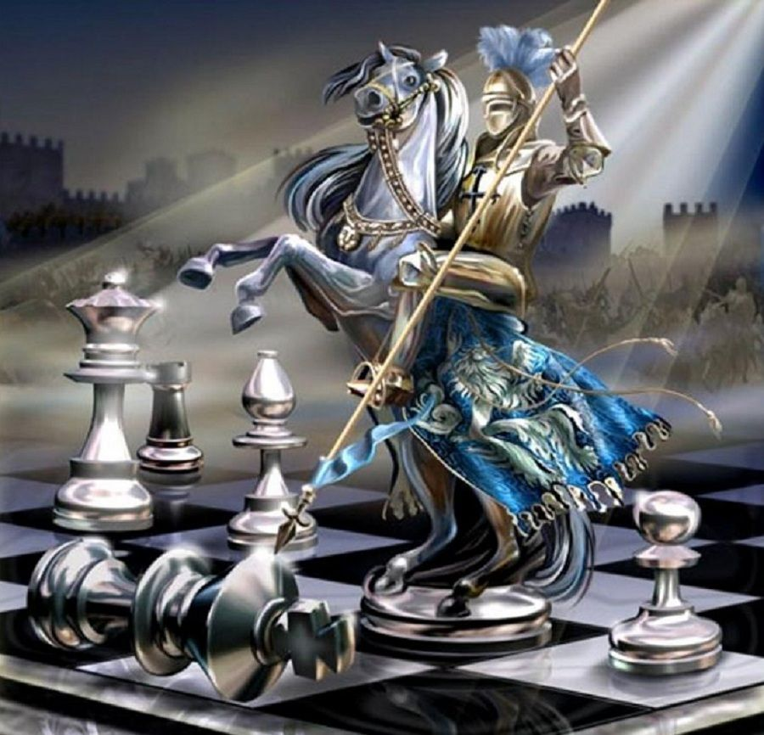
What is a Knight?
Knight A Chess Piece
Moves in the “L” shape i.e. two square vertically/horizontally followed by one square horizontally/vertically respectively.

Slide 3



What is Knight Tour?
Chess Problem that Appeared in the 9th century
General Hamiltonian path problem.
Knight in a chess board must visit all the 64 squares
exactly once.
It’s considered as a challenge cause of knight’s unusual pattern of movement

Slide 4
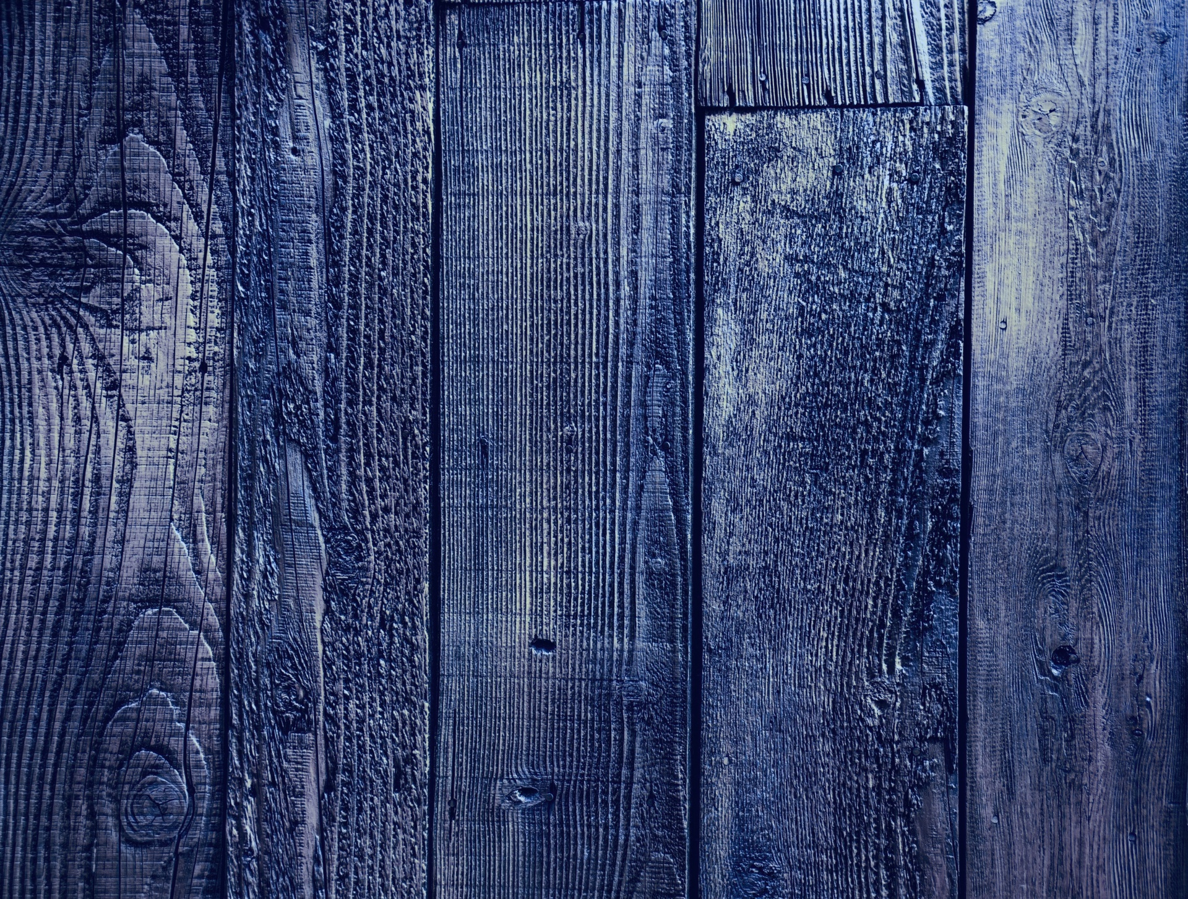

How To Solve It?
Naïve Algorithm
Back Tracking
Warnsdorff’s algorithm
How is DSA linked with knight tour?
Data Structure
Recursion
Algorithm
Back Tracking

Slide 5
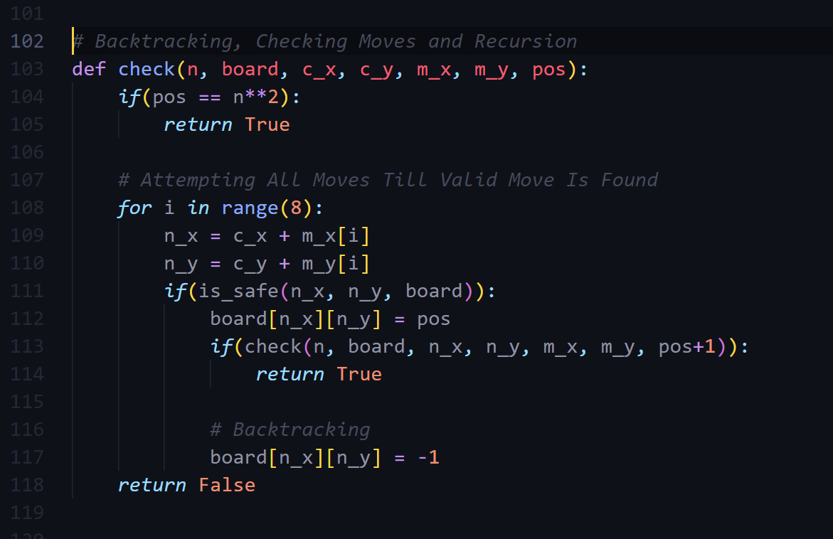
Recursion And Back Tracking

Slide 6
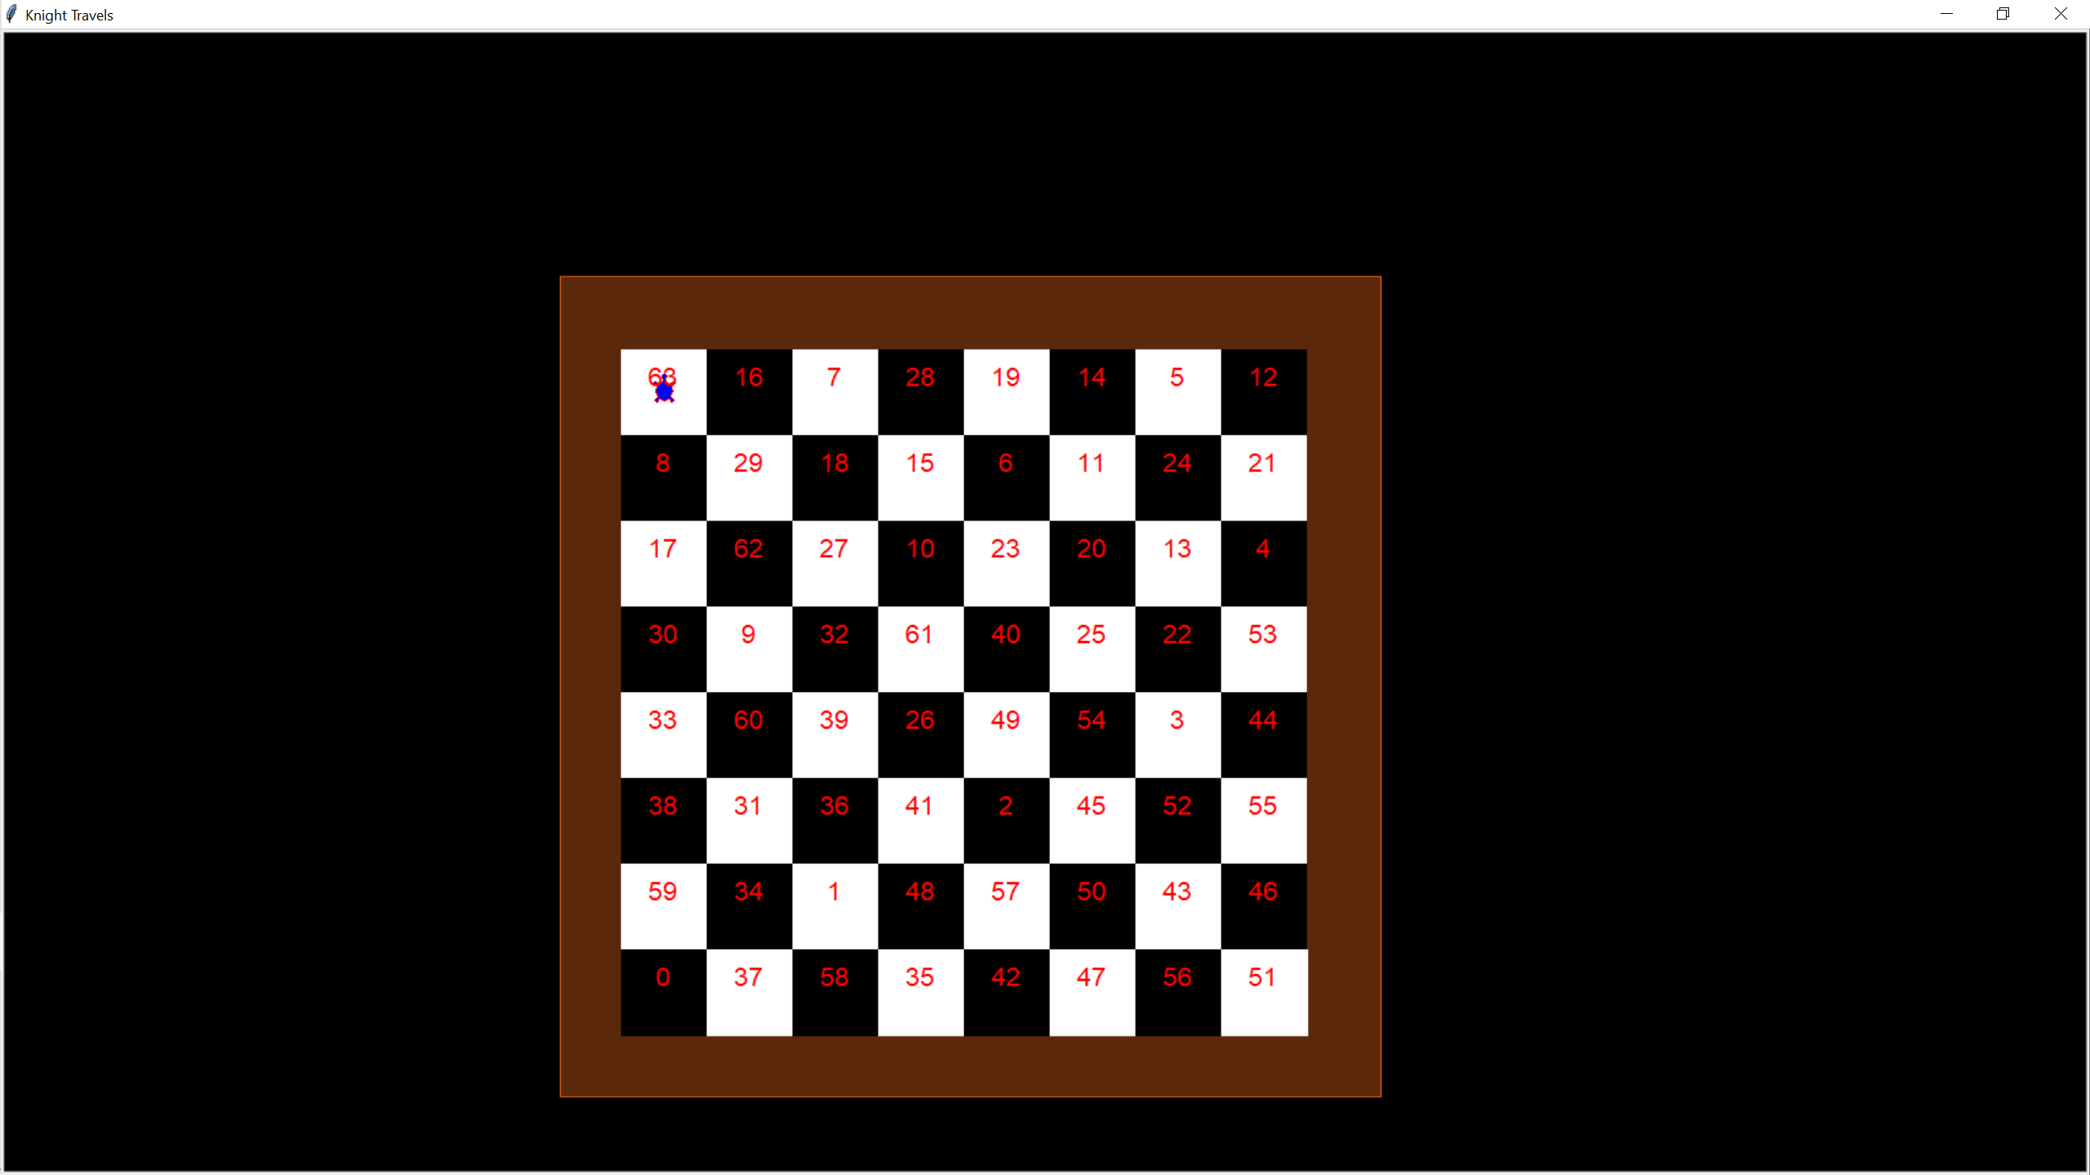
Output

